Slide 1

Table Detection with AI

Slide 2

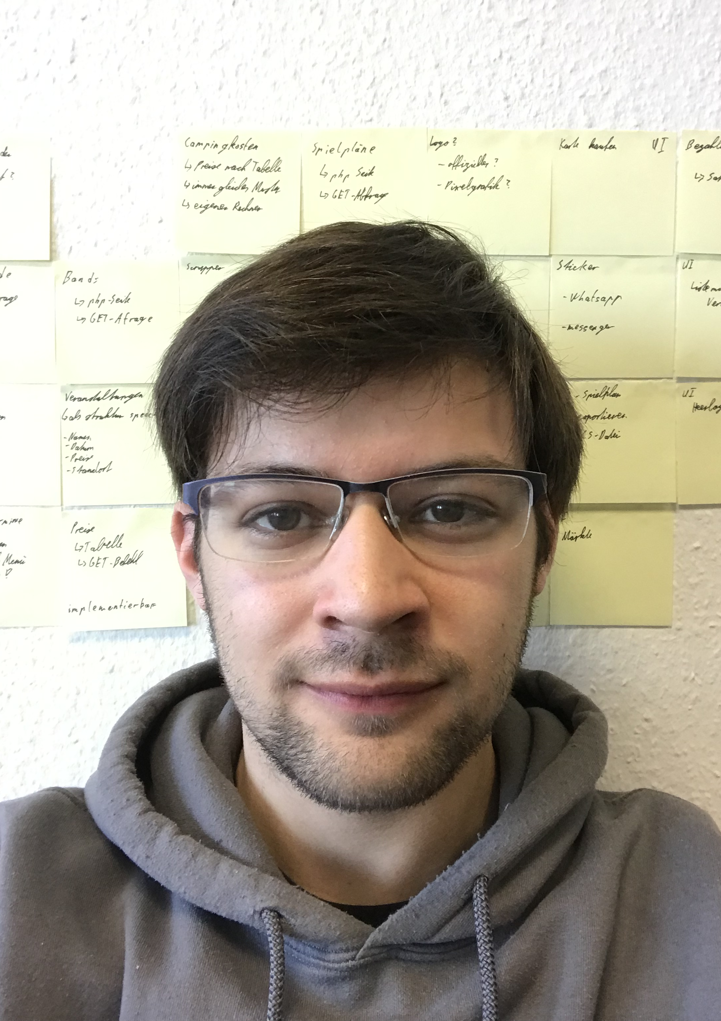
Who am i
Christian Baltzer
Student of Economy Computer Science
University of Applied Science - Fulda

Slide 3
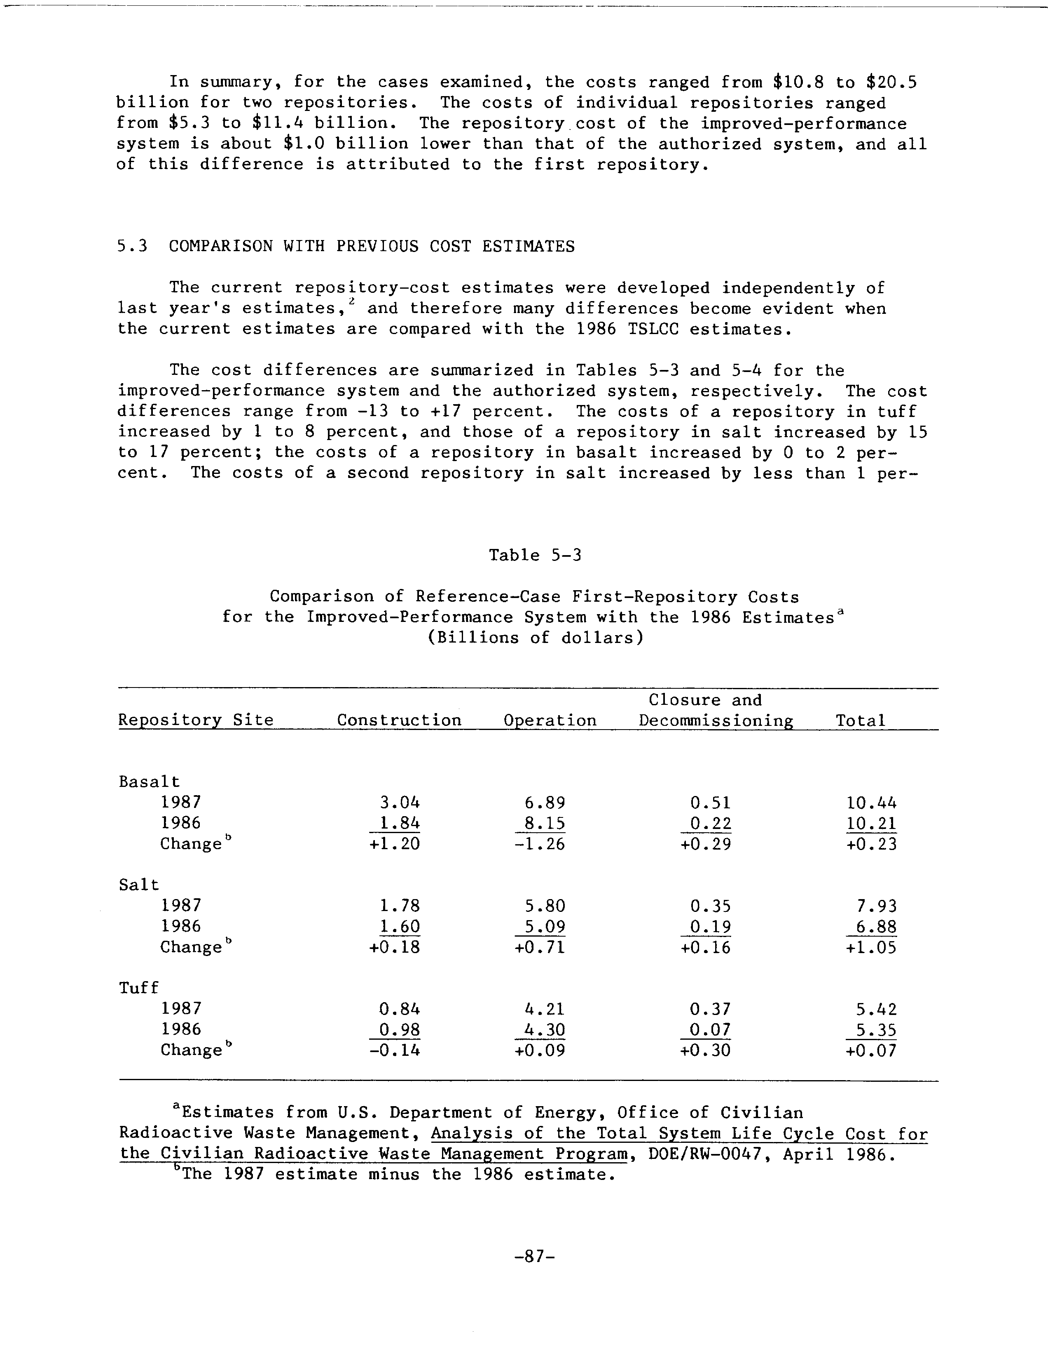
Goal

Slide 4



Notes:
For the simplicity of this Presentation
There has to be a logic to transform the Document into a picture beforehand
- We won’t go into detail here

Slide 5
Task
Find the Table
Extract the Data
Notes:
Where to start

Slide 6
Task 1 Where is the Table?

Slide 7
What is established?
Usable Tool
?
Science
DeepDeSRT
TableNet
Methods
Image Processing
AI
Notes:
No
Would need Metadata
Would need standart Documents
Science
DeepDeSRT
No code
TableNET
Provide more Detail

Slide 8
Image Processing

Slide 9
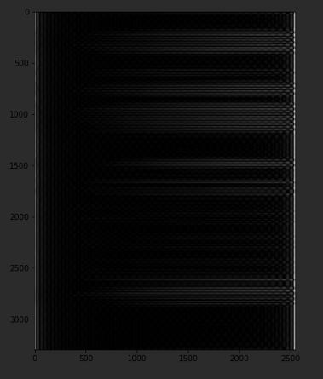
Notes:
Not working, because the library is made for pictures
- Chars not defined enough
No way to change the Library
Need to build own Filter

Slide 10

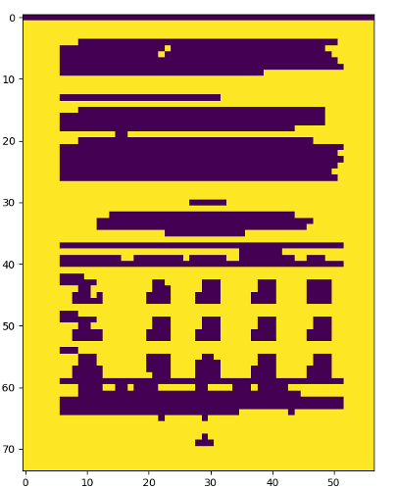

Slide 11

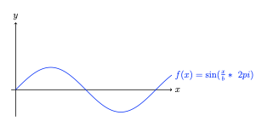

$$f\left(x\right)=sin⁡( \frac{x}{b} ∗2π)$$
Notes:
B = length of the Filter

Slide 12
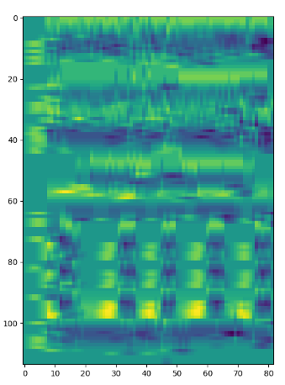
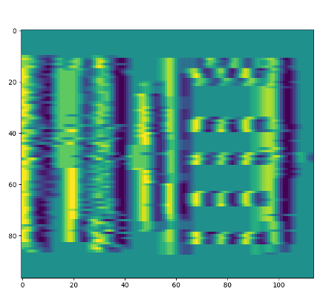

Slide 13
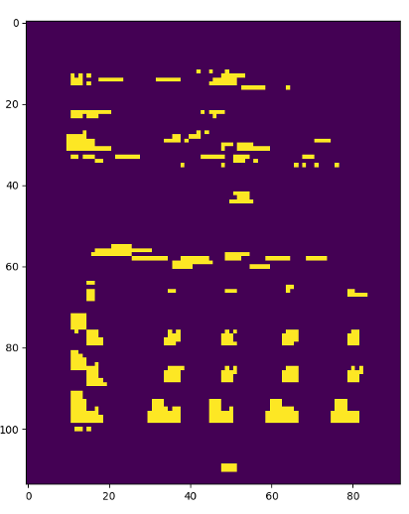
Notes:
not perfekt
- Text has the same struktur
- length of the Filter needs to be adjusted

Slide 14
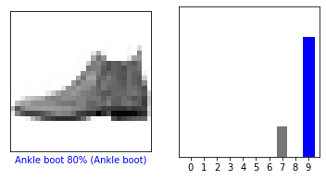
Use AI

Slide 15
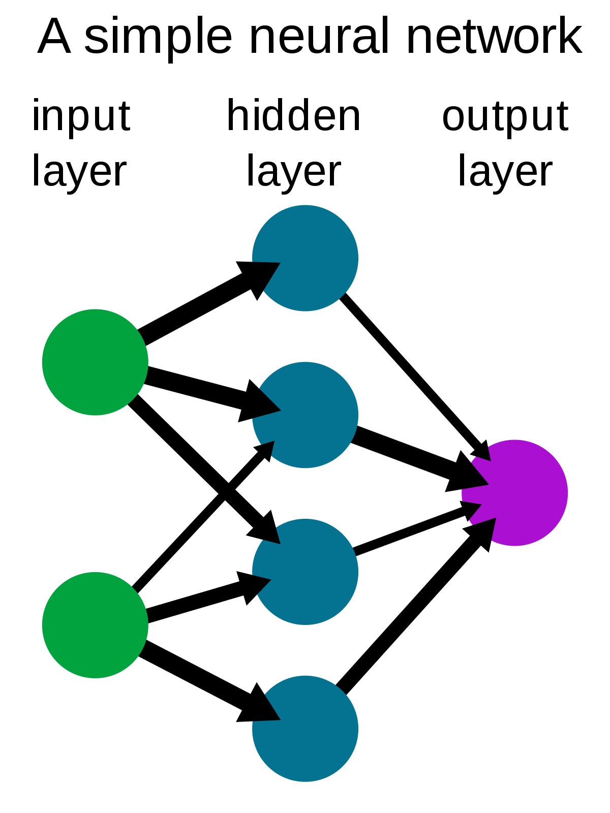
Neuronal Network
Neuron
Notes:
Neuron
Activation Function
Weight
Connect them
Connection has weights
Connect more and we have a cluster

Slide 16
Neuronal Network
Input
Check the Output
Optimize the Network
Repeat
Notes:
repeat a lot

Slide 17
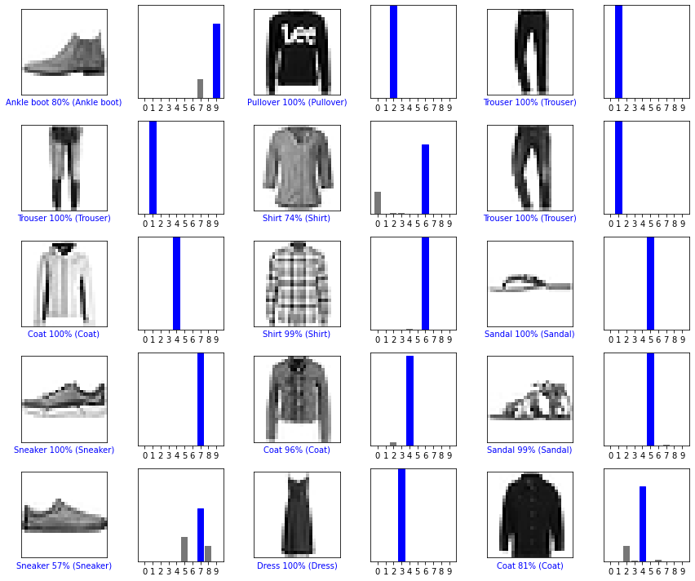
Neuronal Network
Notes:
basic classification

Slide 18
Use AI
Notes:
- Used a Company called Nanonets
- Mark the Structure
- Deliver a finished net

Slide 19
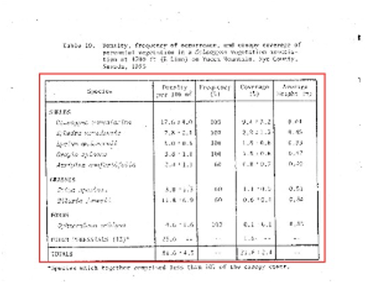
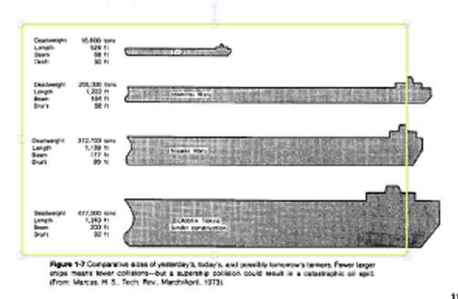
Notes:
- results:
- sometimes no detection
- sometimes good detection
- sometimes wrong detection
- Nanonet is not open , so black box

Slide 20
Can we combine the two methods?

Slide 21
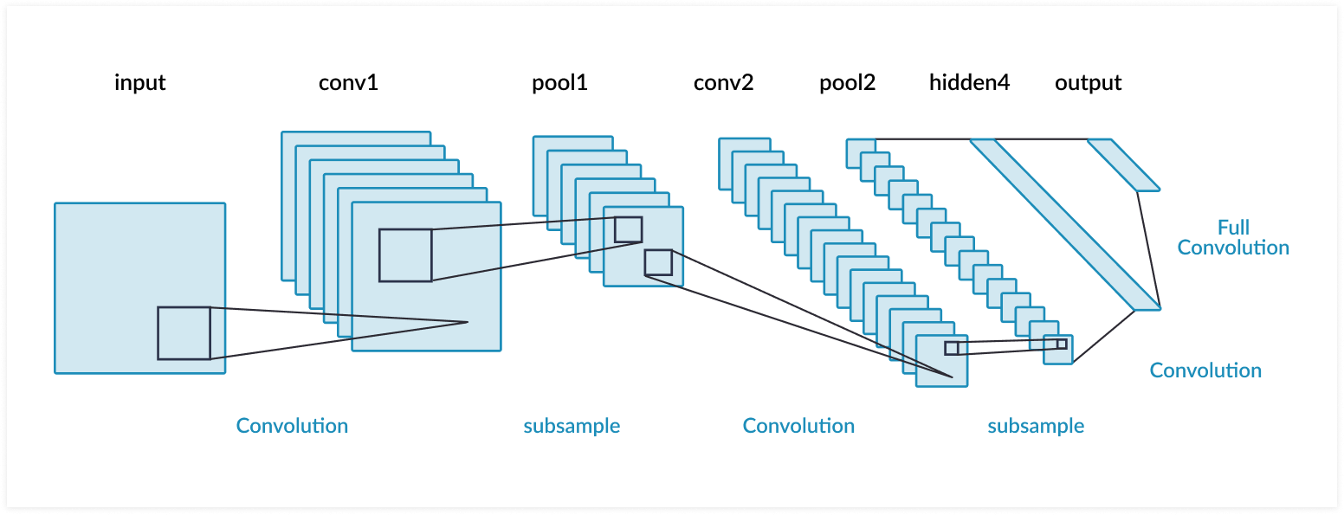
Convolutional Neural Network
Notes:
- cnn
- not working in this case
- Network cost gets higher, accuracy increases
- gets more complicated
- Not usefull when balanced out
-

Slide 22
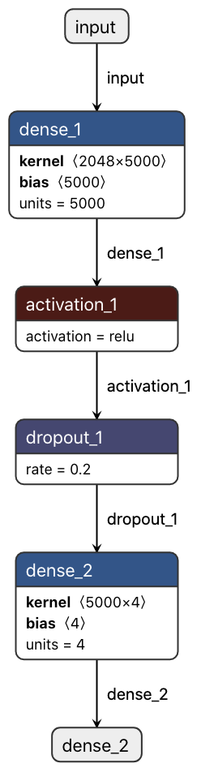
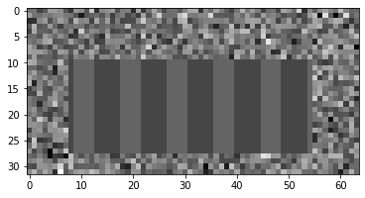
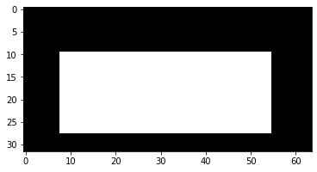
Notes:
- synthetic Data
- table in the middle
- random noise arround it
- picture below
- target output
- White is perfekt for the AI, not for us
- way simpler Network
-

Slide 23
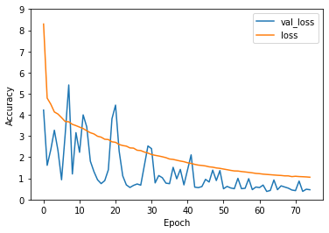
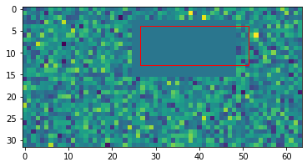

Slide 24
Task 2 Extract the Data

Slide 25
Optical Character Recognition
Notes:
no need to develop
well established techniques

Slide 26

OCR
Free Software
Tesseract
Non-Free Software
Amazon Rekognition and Google OCR
Notes:
Tested multiple Tools

Slide 27
OCR
Free Software
Tesseract
Non-Free Software
Amazon Rekognition and Google OCR
Notes:
Ana vom ML TEam

Slide 28
German Law
ISO 27.00X
Risk Analysis
DSGVO (General Data Protection Regulation)
Art. 25 – Data protection by design and by default
Act to Strengthen the Security of Federal Information Technology (BSIG)
§8 1,1
Criteria Catalogue for Cloud Computing BSI (C5)

Slide 29
Kontext Detection

Slide 30
Klassical AI
Notes:
60%

Slide 31
NEAT

Slide 32
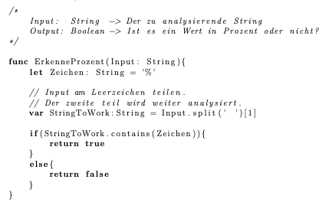
Klassical Algorithm

Slide 33
Perspective

Slide 34
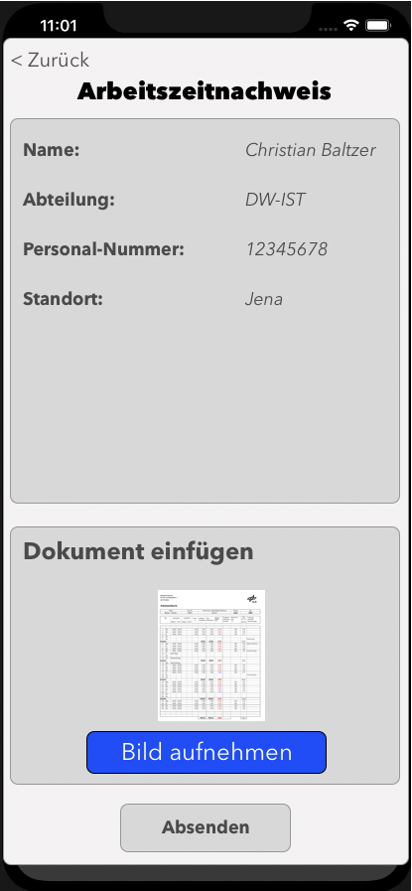
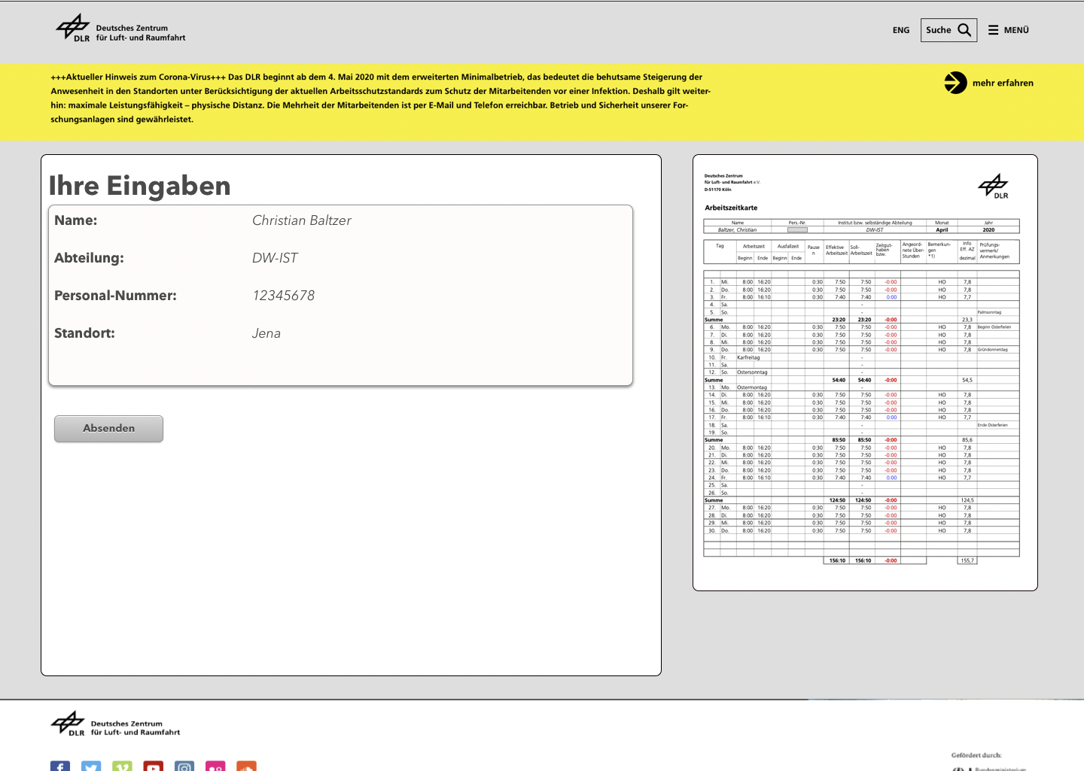
Applications
Notes:
And with this little perspective I would like to End my Presentation

Slide 35
Thanks for your attention
Always Happy Coding

